Slide 1
Operating System Services
One set of operating-system services provides functions that are helpful to the user:
1 User interface - Almost all operating systems have a user interface (UI)
    Varies between Command-Line (CLI), Graphics User Interface (GUI), Batch Interface
  2 Program execution - The system must be able to load a program into memory and to run that program, end execution, either normally or abnormally (indicating error)
Department of CSE, Aditya College of Engineering & Technology, Surampalem

Slide 2
Operating System Services
  3 I/O operations - A running program may require I/O, which may involve a file or an I/O device
  4 File-system manipulation -Programs need to read and write files and directories, create and delete them, search them, list file Information, permission management. OS include permission management to allow or deny access to files/directories based on file ownership.
Department of CSE, Aditya College of Engineering & Technology, Surampalem

Slide 3
Operating System Services
  5 Communications – Processes may exchange information, on the same computer or between computers over a network
    Communications may be via shared memory or through message passing (packets moved by the OS)
  6 Error detection – OS needs to be constantly aware of possible errors
    May occur in the CPU and memory hardware, in I/O devices, in user program
    For each type of error, OS should take the appropriate action to ensure correct and consistent computing
    Debugging facilities can greatly enhance the user’s and programmer’s abilities to efficiently use the system
Department of CSE, Aditya College of Engineering & Technology, Surampalem

Slide 4

A View of Operating System Services
Department of CSE, Aditya College of Engineering & Technology, Surampalem

Slide 5
Operating System Services
Another set of OS functions exists for ensuring the efficient operation of the system itself via resource sharing
  7 Resource allocation - When multiple users or multiple jobs are running concurrently, resources must be allocated to each of them
    There are many types of resources - Some (such as CPU cycles, main memory, and file storage) may have special allocation code, others (such as I/O devices) may have general request and release code .
  8 Accounting – OS keeps track of which users use how much and what kinds of computer resources. This usage statistics is either used for billing or improving computing services
Department of CSE, Aditya College of Engineering & Technology, Surampalem

Slide 6
Operating System Services
  9 Protection and security - The owners of information stored in a multiuser or networked computer system may want to control use of that information, concurrent processes should not interfere with each other.
    Protection involves ensuring that all access to system resources is controlled.
    Security of the system from outsiders requires user authentication, extends to defending external I/O devices from invalid access attempts.
    If a system is to be protected and secure, precautions must be instituted throughout it.
Department of CSE, Aditya College of Engineering & Technology, Surampalem

Slide 7
User Operating System Interface
There are two fundamental approaches for users to interface with the operating system.
command-line interface or command Interpreters.
graphical user interface (GUI).
1 Command Interpreter
Some operating systems include the command interpreter in the kernel. Others, such as Windows XP and UNIX, treat the command interpreter as a special program that is running when a job is initiated or when a user first logs on.
On systems with multiple command interpreters to choose from, the interpreters are known as shells. For example, on UNIX and Linux systems, there are several different shells a user may choose from(Bourne Shell, C Shell, Bourne-Again Shell, Korn Shell)

Slide 8
These commands can be implemented in two general ways.
  In one approach, the command interpreter itself contains the code to execute the command. For example, a command to delete a file may cause the command interpreter to jump to a section of its code that sets up the parameters and makes the appropriate system call.
  An alternative approach—used by UNIX, among other operating systems —implements most commands through system programs. In this case, the command interpreter does not understand the command in any way; it merely uses the command to identify a file to be loaded into memory and executed. Thus, the UNIX command to delete a file
  rm file.txt
  would search for a file called rm, load the file into memory, and execute it with the parameter file.txt
Department of CSE, Aditya College of Engineering & Technology, Surampalem

Slide 9
2 Graphical User Interfaces
A second strategy for interfacing with the operating system is through a user friendly graphical user interface (GUI). Rather than having users directly enter commands via a command-line interface,
A GUI provides a mouse-based window-and-menu system as an interface.
A GUI provides a desktop where the mouse is moved to position its pointer on images, or icons, on the screen (the desktop) that represent programs, files, directories( known as a folder) , and system functions.
Graphical user interfaces first appeared due in part to research taking place in the early 1970s at Xerox PARC research facility.

Slide 10
3 Touch Screen Interface.
Because a either a command-line interface or a mouse-and-keyboard system is impractical for most mobile systems, smartphones and handheld tablet computers typically use a touch-screen interface.
Here, users interact by making gestures on the touch screen— for example, pressing and swiping fingers across the screen.
Both the iPad and the iPhone use the Springboard touch-screen interface.
Department of CSE, Aditya College of Engineering & Technology, Surampalem

Slide 11
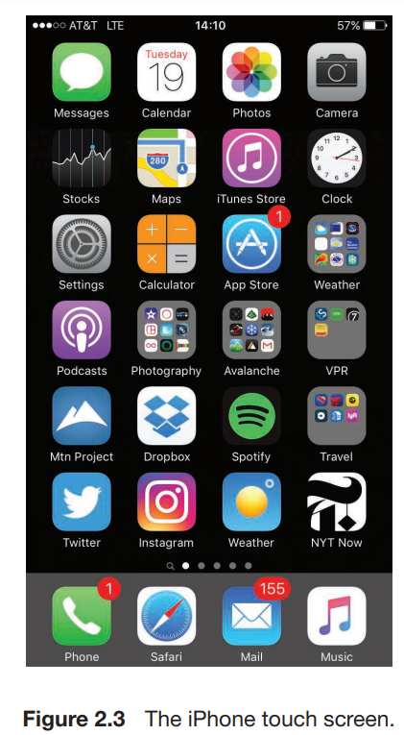
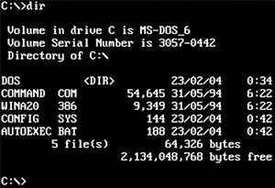
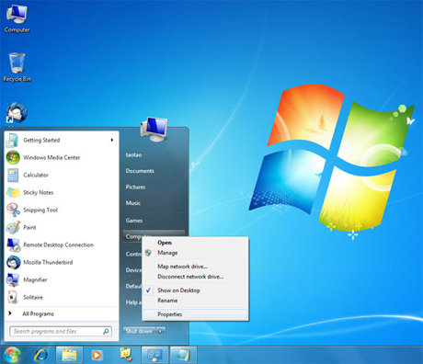

Slide 12
System Calls
System calls provide an interface to the services made available by an operating system.
These calls are generally available as functions written in C and C++.
Example to illustrate how system calls are used:
writing a simple program to read data from one file and copy them to another file. The first input that the program will need is the names of the two files: the input file and the output file.
cp in.txt out.txt
Department of CSE, Aditya College of Engineering & Technology, Surampalem

Slide 13

Example of System Calls
System call sequence to copy the contents of one file to another file
Department of CSE, Aditya College of Engineering & Technology, Surampalem

Slide 14
Handling System Calls : Application Programming Interface
Application developers design programs according to an application programming interface (API).
The API specifies a set of functions that are available to an application programmer, including the parameters that are passed to each function and the return values the programmer can expect.
Three of the most common APIs available to application programmers are
    the Windows API for Windows systems,
    the POSIX API for POSIX-based systems (which include virtually all versions of UNIX, Linux, and macOS), and
    the Java API for programs that run on the Java virtual machine
Department of CSE, Aditya College of Engineering & Technology, Surampalem

Slide 15
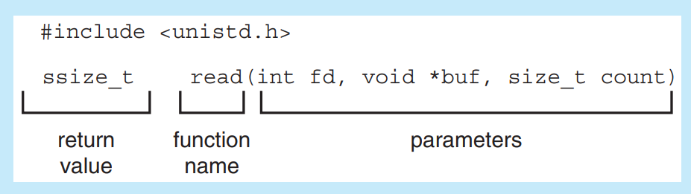
As an example of a standard API, consider the read() function that is available in UNIX and Linux systems. A description of this API appears below:
A program that uses the read() function must include the <unistd.h> header file, as this file defines the ssize t and size t data types (among other things).
Department of CSE, Aditya College of Engineering & Technology, Surampalem

Slide 16
The parameters passed to read() are as follows:
• int fd— the file descriptor to be read
• void *buf— a buffer into which the data will be read
• size_t count— the maximum number of bytes to be read into the buffer.
On a successful read, the number of bytes read is returned. A return value of 0 indicates end of file. If an error occurs, read() returns −1.
Department of CSE, Aditya College of Engineering & Technology, Surampalem

Slide 17
System Call Implementation
Another important factor in handling system calls is the run-time environment (RTE)— the full suite of software needed to execute applications written in a given programming language, including its compilers or interpreters as well as other software, such as libraries and loaders.
Department of CSE, Aditya College of Engineering & Technology, Surampalem

Slide 18
The RTE provides a system-call interface that serves as the link to system calls made available by the operating system.
The system-call interface intercepts function calls in the API and invokes the necessary system calls within the operating system.
Typically, a number is associated with each system call, and the system-call interface maintains a table indexed according to these numbers.
The system call interface then invokes the intended system call in the operating-system kernel and returns the status of the system call.
Department of CSE, Aditya College of Engineering & Technology, Surampalem

Slide 19

API – System Call – OS Relationship
Department of CSE, Aditya College of Engineering & Technology, Surampalem

Slide 20

Standard C Library Example
C program invoking printf() library call, which calls write() system call
Department of CSE, Aditya College of Engineering & Technology, Surampalem

Slide 21
System Call Parameter Passing
Often, more information is required than simply identity of desired system call
  Exact type and amount of information vary according to OS and call
Three general methods used to pass parameters to the OS
  Simplest: pass the parameters in registers
    In some cases, may be more parameters than registers
  Parameters stored in a block, or table, in memory, and address of block passed as a parameter in a register
    This approach taken by Linux and Solaris
  Parameters placed, or pushed, onto the stack by the program and popped off the stack by the operating system
Block and stack methods do not limit the number or length of parameters being passed
Department of CSE, Aditya College of Engineering & Technology, Surampalem

Slide 22

Parameter Passing via Table
Department of CSE, Aditya College of Engineering & Technology, Surampalem

Slide 23
Types of System Calls
        Process control
        File management
        Device management
        Information maintenance
        Communications
        Protection
Department of CSE, Aditya College of Engineering & Technology, Surampalem

Slide 24
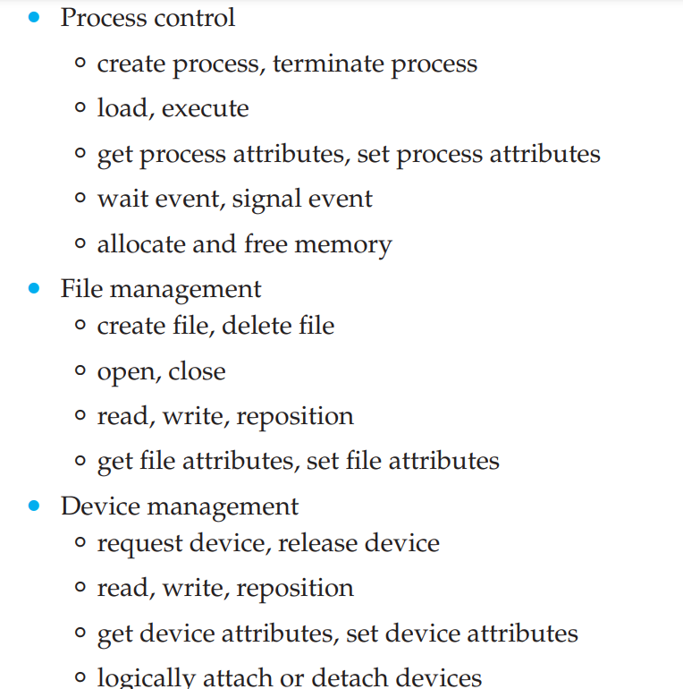
Department of CSE, Aditya College of Engineering & Technology, Surampalem

Slide 25
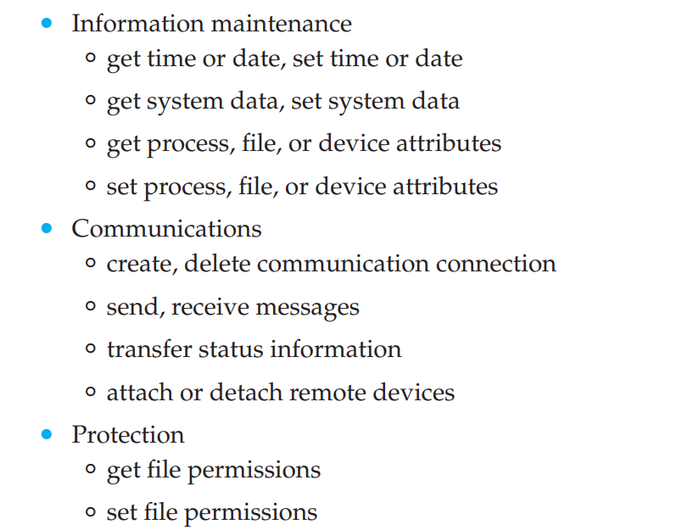
Department of CSE, Aditya College of Engineering & Technology, Surampalem

Slide 26

Examples of Windows and Unix System Calls
Department of CSE, Aditya College of Engineering & Technology, Surampalem

Slide 27
System Programs
System programs provide a convenient environment for program development and execution. They can be divided into:
  File manipulation
  Status information sometimes stored in a File modification
  Programming language support
  Program loading and execution
  Communications
  Background services
  Application programs
Department of CSE, Aditya College of Engineering & Technology, Surampalem

Slide 28
System Programs
Provide a convenient environment for program development and execution
  Some of them are simply user interfaces to system calls; others are considerably more complex
File management - These programs create, delete, copy, rename, print, list, and generally access and manipulate files and directories.
Status information
  Some ask the system for info - date, time, amount of available memory, disk space, number of users
  Others provide detailed performance, logging, and debugging information
  Typically, these programs format and print the output to the terminal or other output devices
  Some systems implement a registry - used to store and retrieve configuration information
Department of CSE, Aditya College of Engineering & Technology, Surampalem

Slide 29
System Programs (Cont.)
File modification
  Text editors to create and modify files
  Special commands to search contents of files or perform transformations of the text
Programming-language support - Compilers, assemblers, debuggers, and interpreters for common programming languages (such as C, C++, Java, and Python) are often provided with the operating system or available as a separate download
Program loading and execution- Once a program is assembled or compiled, it must be loaded into memory to be executed. The system may provide absolute loaders, relocatable loaders, linkage editors, and overlay loaders
Department of CSE, Aditya College of Engineering & Technology, Surampalem

Slide 30
Communications –
  These programs provide the mechanism for creating virtual connections among processes, users, and computer systems.
  They allow users to send messages to one another’s screens, to browse web pages, to send e-mail messages, to log in remotely, or to transfer files from one machine to another.
Department of CSE, Aditya College of Engineering & Technology, Surampalem

Slide 31
System Programs (Cont.)
Background Services
  Launch at boot time
    Some for system startup, then terminate
    Some from system boot to shutdown
  Provide facilities like disk checking, process scheduling, error logging, printing
  Run in user context not kernel context
  Known as services, subsystems, daemons
Application programs
  Don’t pertain to system
  Run by users
  Not typically considered part of OS
  Launched by command line, mouse click, finger poke
Department of CSE, Aditya College of Engineering & Technology, Surampalem

Slide 32
Operating-System Design and Implementation
1 Design Goals:
The first problem in designing a system is to define goals and specifications.
At the highest level, the design of the system will be affected by the choice of hardware and the type of system: traditional desktop/laptop, mobile, distributed, or real time.
Beyond this highest design level, the requirements may be much harder to specify. The requirements can, however, be divided into two basic groups:
user goals - The system should be convenient to use, easy to learn and to use, reliable, safe, and fast
system goals- The system should be easy to design, implement, and maintain; and it should be flexible, reliable, error free, and efficient.
Department of CSE, Aditya College of Engineering & Technology, Surampalem

Slide 33
2 Mechanisms and Policies :
Mechanisms determine how to do something; policies determine what will be done.
  For example, the timer construct is a mechanism for ensuring CPU protection, but deciding how long the timer is to be set for a particular user is a policy decision.
Policies are likely to change across places or over time. A general mechanism flexible enough to work across a range of policies is preferable.
Policy decisions are important for all resource allocation. Whenever it is necessary to decide whether or not to allocate a resource, a policy decision must be made. Whenever the question is how rather than what, it is a mechanism that must be determined.
Department of CSE, Aditya College of Engineering & Technology, Surampalem

Slide 34
3 Implementation :
Once an operating system is designed, it must be implemented.
Early operating systems were written in assembly language.
Now, most are written in higher-level languages such as C or C++, with small amounts of the system written in assembly language. In fact, more than one higher level language is often used.
The lowest levels of the kernel might be written in assembly language and C. Higher-level routines might be written in C and C++, and system libraries might be written in C++.
The advantages of using a higher-level language is the code can be written faster, is more compact, and is easier to understand and debug. An operating system is far easier to port to other hardware if it is written in a higher-level language.
Department of CSE, Aditya College of Engineering & Technology, Surampalem

Slide 35
Operating System Structure
General-purpose OS is collection of very large program and OS components are interconnected and melded into a kernel.
Various ways in which the components are melded to form structure are:
    1 Monolithic Structure
    2 Layered Approach
    3 Microkernels
    4 Modules
    5 Hybrid Systems
Department of CSE, Aditya College of Engineering & Technology, Surampalem

Slide 36
1. Monolithic Structure
The simplest structure for organizing an operating system is no structure at all.
The functionality of the kernel is placed into a single, static binary file that runs in a single address space. This approach—known as a monolithic structure—is a common technique for designing operating systems.
Example of such limited structuring is the original UNIX operating system, which consists of two separable parts:
  the kernel and
  the system programs.
The kernel is further separated into a series of interfaces and device drivers, which have been added and expanded over the years as UNIX has evolved. We can view the traditional UNIX operating system as being layered to some extent.
Department of CSE, Aditya College of Engineering & Technology, Surampalem

Slide 37
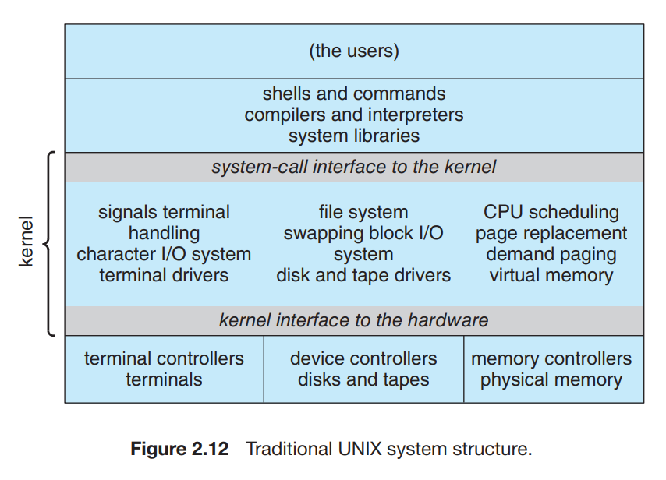
Everything below the system-call interface and above the physical hardware is the kernel.
The kernel provides the file system, CPU scheduling, memory management, and other operating system functions through system calls.
Taken in sum, that is an enormous amount of functionality to be combined into one single address space
Department of CSE, Aditya College of Engineering & Technology, Surampalem

Slide 38
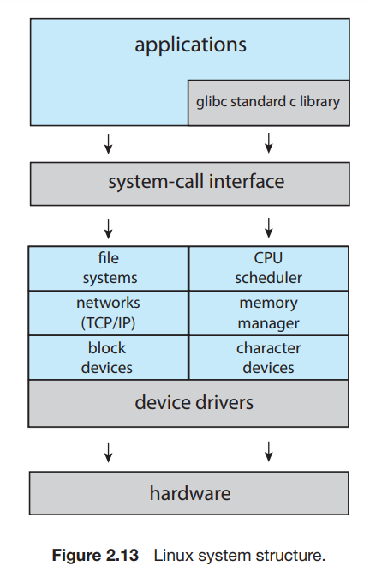
The Linux operating system is based on UNIX and is structured similarly.
Applications typically use the glibc standard C library when communicating with the system call interface to the kernel.
The Linux kernel is monolithic, in that it runs entirely in kernel mode in a single address space, but it does have a modular design that allows the kernel to be modified during run time.
Department of CSE, Aditya College of Engineering & Technology, Surampalem

Slide 39
Disadvantages :
Despite the apparent simplicity of monolithic kernels, they are difficult to implement and extend.
Monolithic kernels do have a distinct performance advantage, however: there is very little overhead in the system-call interface, and communication within the kernel is fast
Department of CSE, Aditya College of Engineering & Technology, Surampalem

Slide 40

2. Layered Structure
The operating system is divided into a number of layers (levels), each built on top of lower layers. The bottom layer (layer 0), is the hardware; the highest (layer N) is the user interface.
With modularity, layers are selected such that each uses functions (operations) and services of only lower-level layers
Department of CSE, Aditya College of Engineering & Technology, Surampalem

Slide 41
A typical operating-system layer—say, layer M—consists of data structures and a set of functions that can be invoked by higher-level layers. Layer M, in turn, can invoke operations on lower-level layers.
Each layer is implemented only with operations provided by lower-level layers. A layer does not need to know how these operations are implemented; it needs to know only what these operations do.
  Hence, each layer hides the existence of certain data structures, operations, and hardware from higher level layers.
The main advantage of the layered approach is simplicity of construction and debugging.
Layered systems have been successfully used in computer networks (such as TCP/IP) and web applications.
Department of CSE, Aditya College of Engineering & Technology, Surampalem

Slide 42
3. Microkernels
As UNIX expanded, the kernel became large and difficult to manage.
In the mid-1980s, researchers at Carnegie Mellon University developed an operating system called Mach that modularized the kernel using the microkernel approach.
This method structures the operating system by removing all nonessential components from the kernel and implementing them as user level programs that reside in separate address spaces. The result is a smaller kernel.
The main function of the microkernel is to provide communication between the client program and the various services that are also running in user space.
Communication is provided through message passing.
Department of CSE, Aditya College of Engineering & Technology, Surampalem

Slide 43
For example, if the client program wishes to access a file, it must interact with the file server. The client program and server never interact directly. Rather, they communicate indirectly by exchanging messages with the microkernel.
One benefit of the microkernel approach is that it makes extending the operating system easier.
All new services are added to user space and consequently do not require modification of the kernel.
Best-known illustration of a microkernel operating system is Darwin, the kernel component of the macOS and iOS operating systems
Department of CSE, Aditya College of Engineering & Technology, Surampalem

Slide 44

Microkernel System Structure
Department of CSE, Aditya College of Engineering & Technology, Surampalem

Slide 45
4. Modules
Many modern operating systems implement loadable kernel modules(LKM)
  Uses object-oriented approach
  Each core component is separate
  Each talks to the others over known interfaces
  Each is loadable as needed within the kernel
Overall, similar to layers but with more flexible
  Linux, Solaris, etc
Department of CSE, Aditya College of Engineering & Technology, Surampalem

Slide 46
Linux uses loadable kernel modules, primarily for supporting device drivers and file systems.
LKMs can be “inserted” into the kernel as the system is started (or booted) or during run time, such as when a USB device is plugged into a running machine.
If the Linux kernel does not have the necessary driver, it can be dynamically loaded. LKMs can be removed from the kernel during run time as well
Department of CSE, Aditya College of Engineering & Technology, Surampalem

Slide 47

Solaris Modular Approach
Department of CSE, Aditya College of Engineering & Technology, Surampalem

Slide 48
Hybrid Systems
Most modern operating systems are actually not one pure model
  Hybrid combines multiple approaches to address performance, security, usability needs
  Linux and Solaris kernels in kernel address space, so monolithic, plus modular for dynamic loading of functionality
  Windows mostly monolithic, plus microkernel for different subsystem personalities
Apple Mac OS X hybrid, layered, Aqua UI plus Cocoa programming environment
  Below is kernel consisting of Mach microkernel and BSD Unix parts, plus I/O kit and dynamically loadable modules (called kernel extensions)
Department of CSE, Aditya College of Engineering & Technology, Surampalem

Slide 49
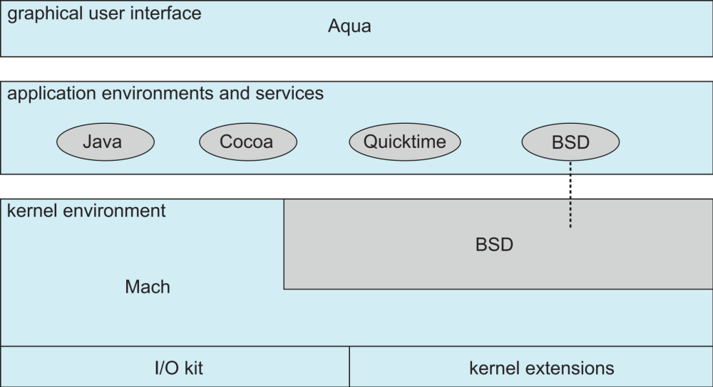
Mac OS X Structure
Department of CSE, Aditya College of Engineering & Technology, Surampalem

Slide 50
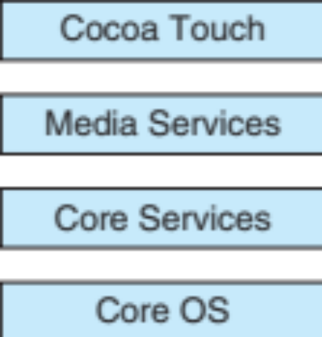
iOS
Apple mobile OS for iPhone, iPad
  Structured on Mac OS X, added functionality
  Does not run OS X applications natively
    Also runs on different CPU architecture (ARM vs. Intel)
  Cocoa Touch Objective-C API for developing apps
  Media services layer for graphics, audio, video
  Core services provides cloud computing, databases
  Core operating system, based on Mac OS X kernel
Department of CSE, Aditya College of Engineering & Technology, Surampalem

Slide 51
Android
Developed by Open Handset Alliance (mostly Google)
  Open Source
Similar stack to IOS
Based on Linux kernel but modified
  Provides process, memory, device-driver management
  Adds power management
Runtime environment includes core set of libraries and Dalvik virtual machine
  Apps developed in Java plus Android API
    Java class files compiled to Java bytecode then translated to executable than runs in Dalvik VM
Libraries include frameworks for web browser (webkit), database (SQLite), multimedia, smaller libc
Department of CSE, Aditya College of Engineering & Technology, Surampalem

Slide 52
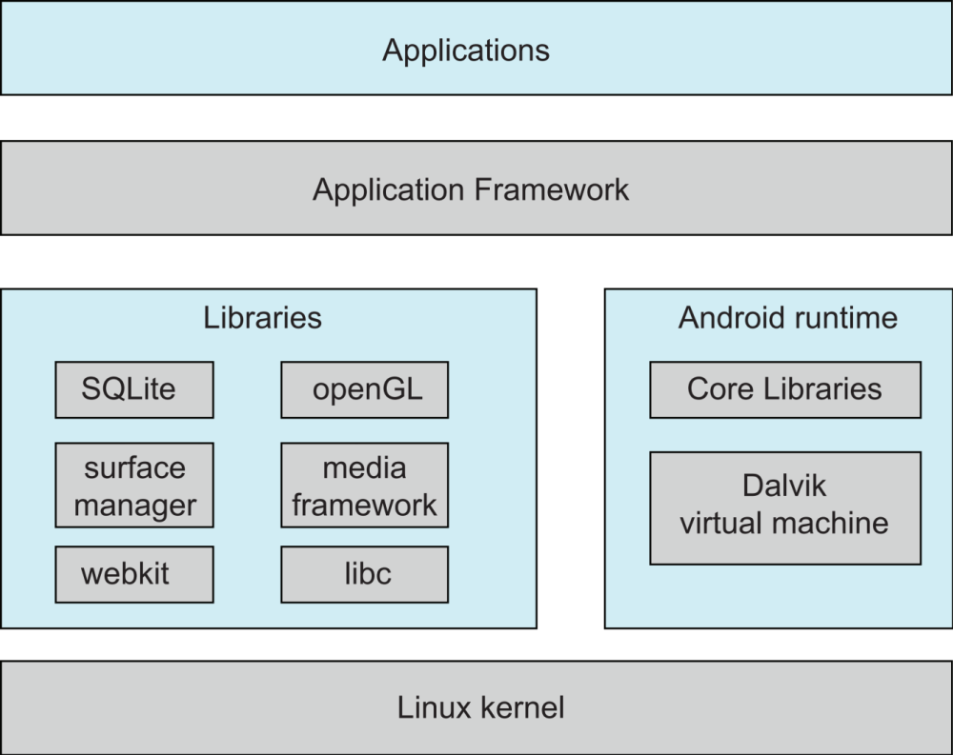
Android Architecture
Department of CSE, Aditya College of Engineering & Technology, Surampalem

Slide 53
Building and Booting an Operating System
It is possible to design, code, and implement an operating system specifically for one specific machine configuration
Operating systems are designed to run on any of a class of machines with a variety of peripheral configurations.
Department of CSE, Aditya College of Engineering & Technology, Surampalem

Slide 54
1 Operating-System Generation
If you are generating (or building) an operating system from scratch, you must follow these steps:
  1. Write the operating system source code (or obtain previously written source code).
  2. Configure the operating system for the system on which it will run.
  3. Compile the operating system.
  4. Install the operating system.
  5. Boot the computer and its new operating system.
Department of CSE, Aditya College of Engineering & Technology, Surampalem

Slide 55
2 System Boot
The process of starting a computer by loading the kernel is known as booting the system. On most systems, the boot process proceeds as follows:
  1. A small piece of code known as the bootstrap program or boot loader locates the kernel.
  2. The kernel is loaded into memory and started.
  3. The kernel initializes hardware.
  4. The root file system is mounted.
Department of CSE, Aditya College of Engineering & Technology, Surampalem

Slide 56
When the computer is first powered on, a small boot loader located in nonvolatile firmware known as BIOS (basic input/output system) is run.
This initial boot loader usually does nothing more than load a second boot loader, which is located at a fixed disk location called the boot block.
  The program stored in the boot block may be sophisticated enough to load the entire operating system into memory and begin its execution.
  It is simple code (as it must fit in a single disk block) and knows only the address on disk and the length of the remainder of the bootstrap program.
Department of CSE, Aditya College of Engineering & Technology, Surampalem

Slide 57
GRUB is an open-source bootstrap program for Linux and UNIX systems.
  Boot parameters for the system are set in a GRUB configuration file, which is loaded at startup.
  GRUB is flexible and allows changes to be made at boot time, including modifying kernel parameters and even selecting among different kernels that can be booted
Department of CSE, Aditya College of Engineering & Technology, Surampalem

Slide 58
Operating-System Debugging
Debugging is the activity of finding and fixing errors in a system, both in hardware and in software.
Performance problems are considered bugs, so debugging can also include performance tuning, which seeks to improve performance by removing processing bottlenecks
Operating System Debugging involves :
  1 Failure Analysis
  2 Performance Monitoring and Tuning
  3 Tracing
  4 BCC
Department of CSE, Aditya College of Engineering & Technology, Surampalem

Slide 59
1. Failure Analysis:
If a process fails, most operating systems write the error information to a log file to alert system operators or users that the problem occurred.
The operating system can also take a core dump—a capture of the memory of the process— and store it in a file for later analysis. (Memory was referred to as the “core” in the early days of computing.)
Running programs and core dumps can be used by a debugger, which allows a programmer to explore the code and memory of a process.
A failure in the kernel is called a crash. When a crash occurs, error information is saved to a log file, and the memory state is saved to a crash dump.
Department of CSE, Aditya College of Engineering & Technology, Surampalem

Slide 60
2 Performance Monitoring and Tuning
  Performance tuning seeks to improve performance by removing processing bottlenecks.
  Windows systems provide the Windows Task Manager, a tool that includes information for current applications as well as processes, CPU and memory usage, and networking statistics
  The operating system must have some means of computing and displaying measures of system behavior. Tools may be characterized as providing either per-process or system-wide observations.
  To identify bottlenecks, we must be able to monitor system performance using counters.
Department of CSE, Aditya College of Engineering & Technology, Surampalem

Slide 61
Counters :
Operating systems keep track of system activity through a series of counters, such as the number of system calls made or the number of operations performed to a network device or disk.
The following are examples of Linux tools that use counters:
Per-Process
  • ps—reports information for a single process or selection of processes
  • top—reports real-time statistics for current processes
System-Wide
  • vmstat—reports memory-usage statistics
  • netstat—reports statistics for network interfaces
  • iostat—reports I/O usage for disks
Department of CSE, Aditya College of Engineering & Technology, Surampalem

Slide 62
3. Tracing
Tracing tools collect data for a specific event—such as the steps involved in a system-call invocation.
The following are examples of Linux tools that trace events:
  Per-Process
    • strace— traces system calls invoked by a process
    • gdb—a source-level debugger
  System-Wide
    • perf—a collection of Linux performance tools
    • tcpdump—collects network packets
Department of CSE, Aditya College of Engineering & Technology, Surampalem

Slide 63
4. BCC
Debugging the interactions between user-level and kernel code is nearly impossible without a toolset that understands both sets of code and can instrument their interactions
BCC (BPF Compiler Collection) is a rich toolkit that provides tracing features for Linux systems.
BCC is a front-end interface to the eBPF (extended Berkeley Packet Filter) tool.
The BPF technology was developed in the early 1990s for filtering traffic across a computer network.
The “extended” BPF (eBPF) added various features to BPF.
  eBPF programs are written in a subset of C and are compiled into eBPF instructions, which can be dynamically inserted into a running Linux system.
Department of CSE, Aditya College of Engineering & Technology, Surampalem

Slide 64
Although eBPF provides a rich set of features for tracing within the Linux kernel, it traditionally has been very difficult to develop programs using its C interface.
BCC was developed to make it easier to write tools using eBPF by providing a front-end interface in Python.
A BCC tool is written in Python and it embeds C code that interfaces with the eBPF instrumentation, which in turn interfaces with the kernel.
The BCC tool also compiles the C program into eBPF instructions and inserts it into the kernel using either probes or tracepoints, two techniques that allow tracing events in the Linux kernel.
Department of CSE, Aditya College of Engineering & Technology, Surampalem

